Slide 1
Life Balance
Spiritual (reflecting)
(15 min)
Physical
(moving)
(15 min)
Social
(intimacy)
(15 min)
Aspirational
(planning)
(15 min)
Notes:
What you put your attention on, grows….TV, Family, Education, Porn, Internet
We need to spend 15 minutes a day in each area.
When only put attention on 3 areas and not 4, we become imbalanced, unsuccessful, and miserable.
We could thrive in the spiritual area: great relationship with divine, peace of mind….but physically: often sick, stressed, no energy….WHAT GOOD IS IT?
We could thrive physically: in great shape, eat well, good energy….but aspirationally, we lack things we desire in life and life is hum drum with no motivation to improve,
We could thrive aspirationally: success in everything we touch, accomplish all our goals….
but socially we’re at odds with our spouse, kids hate us, and our friends don’t call us
WE could thrive in the Social area: good reationships, active in our community but spiritually: we neglect our own needs, lost sense of self or purpose in life and feel emptiness

Slide 2
15 minutes: Spiritual Reflecting
Spend 15 min. a day meditating, journaling, reflecting, prayer, etc.
Home altar: Catholic joke
Use earplugs: Magic red silk, balloon trick
Keep things flowing………
Where? While car warming up, under a tree, office, in bathroom, in closet with kids, home
It charges your mental batteries to deal with stress.
Try yoga, chi gong, breathing
Sleep 7 – 8 hours
Notes:
Meditating, Journaling, Walking/sitting in nature, Praying
Studies show an Inner Ritual keeps one balanced healthy and strong
Home altar: candle, sage, pictures, religious symbols
Meditation demonstration or Balloon Trick
It creates insight and inspiraton: Magic – Red Silk
It keeps things flowing physically (stroke, heart attack) and emotionally (depression)
When and where? While car warms up, in bathroom, in closet with kids away, office
It charges our mental batteries…inflates flat tires (energy)
Try yoga, qi Gong, Breathing,
Sleep 7- 8 hours

Slide 3
15 minutes: Physical: Working out
¼ million people die yearly from physical inactivity
Exercise reduces risk of diabetes, osteoporosis, breast cancer, arthritis, and heart disease.
Seligman, 1994 minimal exercise is better.
Exercises: Aerobic, stretching, muscle resistance

Slide 4
Nutrition
Keep a food diary
Don’t combine starches and proteins
Substitutes: mayo, butter, sweets, meat, cheese, chocolate, sugar, aspirin, milk, salt.
The largest proportion of health claims in a hospital are circulatory problems related to smoking and a high fat diet -Vitality Journal, Managing Health

Slide 5
15 minutes: Planning Goals
Victor Frankl and others lived in the holocaust due to a purpose/goal.
Make it Specific (going to the moon, Ali).
Make it Achievable: reach ceiling, 4 terms…, crabs, only tell those who will encourage you.
Make it Believable: 4 min. mile, SAT story, my goal might be possible if, when, after, with, however

Slide 6
15 minutes: Planning Goals
Make it Desirable: be willing to take the risks and sacrifices
Often, we’ll only want goals if they’re convenient, nobody tells us no, there’s no hoops to jump through, etc.
Make it Measurable: “If you don’t write your goals down, you’ll be working for somebody who does.”
Yale University (1953)

Slide 7
15 minutes: Planning Goals
Write your goals down. Have a to-do list or non to do list...Invisible Deck
Use a daily planner
Double your failure rate!
Have family, self-improvement, educational/career, financial , leisure goals.
15 minutes a day planning goals saves 2 1/4 hours of unnecessary effort!

Slide 8
15 min: Social: Intimate Communication

Slide 9
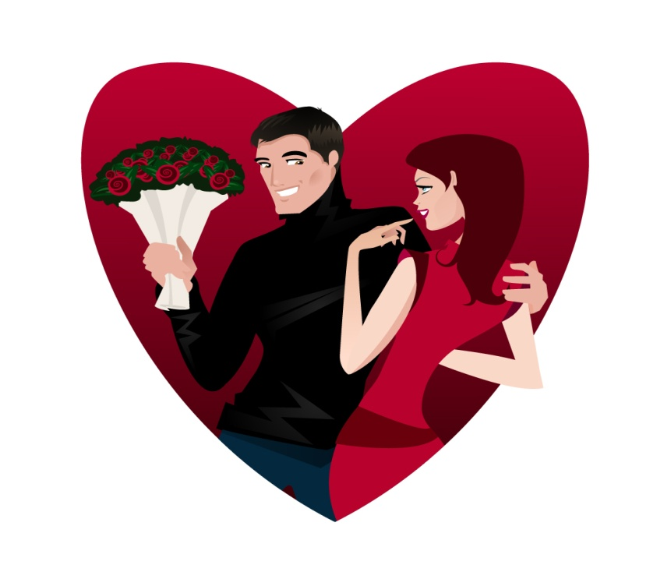
15 min: Social: Intimate Communication
What is the leading cause of death? It’s loneliness!!
Love and community have a stronger effect on our health than lifestyle, drugs, diet, surgery, and genetics. Dean Ornish – Book: Love and Survival.
The longest living community with zero heart disease found in Rosita, Penn. The AMA and AHA expected jogging, fiber-eating meditators and found obese, meat-eating, smokers but they had community.

Slide 10
15 min: Social: Intimate Communication
Coma patient “If you die, I’ll kill you.”
Master your communication skills by:
Listening: (mirror, validate, and empathy)
Asserting: Euphemisms; speak directly
Tone: “I didn’t say she stole the money.”
Tolerance: improve communication with different people and gender…men: why attracted to needy, controlling
Women: draws, treats, brain.
Make words true, kind, necess.

Slide 11
To have Life Balance……
You don’t need Money to thrive in the Spiritual area.
You don’t need a Gym to thrive in the Physical area.
You don’t need a Motivational Guru to thrive in the Aspirational area.
You don’t need an Internet porn site to thrive in the Social area.

Slide 12
In closing…
The bottle – When we’re not in blance, we struggle and sweat to fill our empty lives with things we want but we don’t end up ful-filled.
When we’re in balance, we tend to manage stress better, make better decisions, and things we want tend to flow effortlessly into our lives.
212 degrees….a significant change occurs
SAT ending: She thrived aspirationally
3 kinds of people: Make life balance happen for you…nobody else will do it for you.

