Slide 1
Common Misconceptions
Propagated by ????

Slide 2
1. Public Employees Are Overpaid
“Wisconsin is one of 41 states where public employees earn higher average pay and benefits than private workers in the same state, a USA TODAY analysis finds.”
http://www.usatoday.com/news/nation/2011-03-01-1Apublicworkers01_ST_N.htm

Slide 3
1. Public Employees Are Overpaid
BUT…
“Controlling for education, experience, organizational size, gender, race, ethnicity, citizenship, and disability reveal that employees of both state and local governments in Wisconsin earn less than comparable private sector employees….”

Slide 4
1. Public Employees Are Overpaid
IN FACT…
“Wisconsin public employees earn 4.8% less in total compensation per hour than comparable full-time employees in Wisconsin’s private sector.”
http://www.epi.org/publication/are_wisconsin_public_employees_over- compensated/

Slide 5
1. Public Employees Are Overpaid
WHY???
“59% of full-time Wisconsin public sector workers hold at least a four-year college degree, compared with 30% of full-time private sector workers.”

Slide 6
2. Everything We Buy is Made in China

Slide 7
2. Everything We Buy is Made in China
IN FACT…
Goods and services from China accounted for only 2.7% of U.S. personal consumption expenditures in 2010. (http://www.frbsf.org/publications/economics/letter/2011/el2011- 25.html?utm_source=home)

Slide 8
2. Everything We Buy is Made in China
WHY???
Chinese imported goods consist mainly of furniture and household equipment; other durables; and clothing and shoes.
In the clothing and shoes category, 35.6% of U.S. consumer purchases in 2010 was of items with the “Made in China” label.

Slide 9
2. Everything We Buy is Made in China

Slide 10
Imports as % of GDP

Slide 11
Net Trade as % of GDP

Slide 12
3. China Owns Most US Debt
Notes:
http://www.gao.gov/special.pubs/longterm/debt/debtbasics.html

Slide 13
3. China Owns Most US Debt
As of July 2011, the US National Debt was approximately $14.3T
(Source: US Treasury)
Notes:
http://www.gao.gov/special.pubs/longterm/debt/debtbasics.html

Slide 14
3. China Owns Most US Debt
Foreign investors hold $4.5T
China holds $1.17T
Japan holds $.92T
Britain holds $.35T
Notes:
http://www.gao.gov/special.pubs/longterm/debt/debtbasics.html

Slide 15
3. China Owns Most US Debt
Foreign investors hold $4.5T
China holds $1.17T
Japan holds $.92T
Britain holds $.35T
Domestic US investors hold $5.2T
Notes:
http://www.gao.gov/special.pubs/longterm/debt/debtbasics.html

Slide 16
3. China Owns Most US Debt
Foreign investors hold $4.5T
China holds $1.17T
Japan holds $.92T
Britain holds $.35T
Domestic US investors hold $5.2T
The Federal Reserve system of banks and other US intra-governmental holdings account for $4.6T
E.g. Social Security and Medicare
Notes:
http://www.gao.gov/special.pubs/longterm/debt/debtbasics.html

Slide 17
4. Obama Caused the Debt
National debt is the cumulative Federal budget deficits (and surpluses)

Slide 18
4. Obama Caused the Debt

Slide 19
4. Source of Debt?
The national debt is the cumulative Federal budget deficits (and surpluses)
Budget Deficit
Government Expenditures > Tax Revenues

Slide 20
4. Source of Debt?
National debt is the cumulative Federal budget deficits (and surpluses)
Budget Deficit
Government Expenditures > Tax Revenues

Slide 21
4. Source of Debt?
National debt is the cumulative Federal budget deficits (and surpluses)
Budget Deficit
Government Expenditures > Tax Revenues

Slide 22
4. Source of Debt?
National debt is the cumulative Federal budget deficits (and surpluses)
Budget Deficit
Government Expenditures > Tax Revenues
a) Government spending increased
b) Tax revenues fell

Slide 23
4a. Government Spending Increased?

Slide 24
4b. Tax Revenues Have Fallen?

Slide 25
4b. Tax Revenues Have Fallen!!!

Slide 26
4b. Tax Revenues Have Fallen!!!

Slide 27
4b. Tax Revenues Have Fallen

Slide 28
4b. Tax Revenues Have Fallen

Slide 29
5. Debt Accumulated By Political Party
Which party held the presidency over the largest increases in national debt?

Slide 30
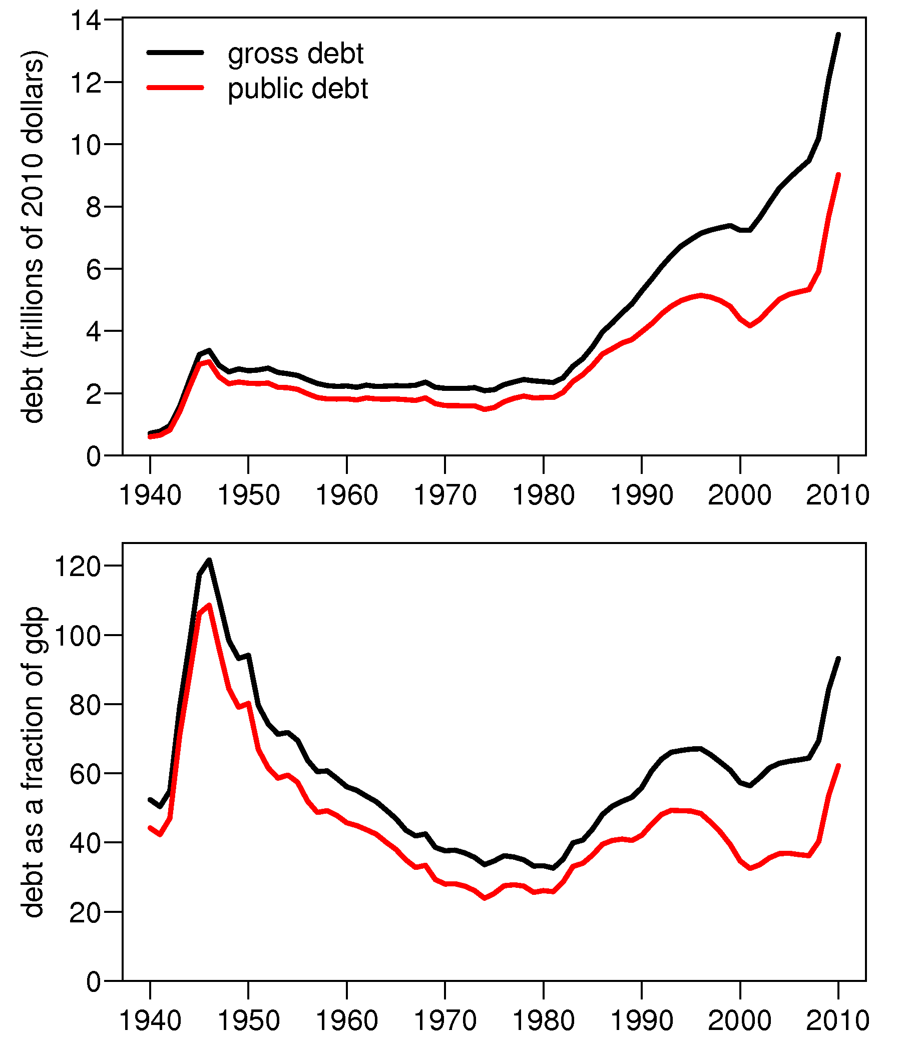
5. Debt Accumulated By Political Party

Slide 31
5. Debt Accumulated By Political Party

Slide 32
5. Debt Accumulated By Political Party
CASE STUDY
2009 FISCAL YEAR (FY) DEFICIT = 10% of GDP
Obama or Bush???
According to the CBO's January 2009 estimate for FY 2009, the projected deficit was $1.18T
These estimates were made before Obama took office, based on existing policy, and did not take into account any actions that Obama might implement

Slide 33
5. Debt By Political Party
According to CBO, the end of FY 2009, ended with a deficit of $1.4T (vs projected $1.18T)
Thus the deficit came in $223 billion higher than projected, but spending was $28 billion and revenues were $251 billion less than expected.

Slide 34
6. TARP = BANK BAILOUT
Big banks and fat cats got billions of free money.

Slide 35
6. TARP = BANK BAILOUT
In early October 2008, Treasury launched a series of programs to stabilize the nation’s banking institutions. A total of $245 billion was invested in banking institutions.

Slide 36
6. TARP = BANK BAILOUT
In early October 2008, Treasury launched a series of programs to stabilize the nation’s banking institutions. A total of $245 billion was invested in banking institutions.
As of March 30, 2011, the Treasury has recovered more than 100% of that amount through repayments, dividends, interest, and other income.

Slide 37
6. TARP = BANK BAILOUT
IN FACT…
The Treasury estimates the bank programs will result in a lifetime positive return for taxpayers of approximately $20 billion

Slide 38
7. Lowering Corporate Income Taxes Creates Jobs

Slide 39
7. Lowering Corporate Income Taxes Creates Jobs
“Do the Math -- Lower Corporate Tax Rates = More Jobs, Growing Economy”
http://www.foxnews.com/opinion/2011/04/08/math-lower-corporate-tax-rates-jobs-growing-economy/

Slide 40
7. Lowering Corporate Income Taxes Creates Jobs
Would you invest $90 in a project if you expected a $100 return → Yes, Profit=$10
Would you invest $90 in a project if you expected a $80 return → No, Loss=$10
-But, what if we lowered the corporate income tax rate to 5%, 2%, 0%??? Still No!

Slide 41
7. Lower Corporate Income Taxes Creates Jobs
Economic theory finds that incentives which increase after-tax profits do not generally induce much new hiring or production.
Increase cash-flow instead.

Slide 42
7. Lower Corporate Income Tax Increases Investment
In 2010, Corporations earned record profits of $1.68 trillion
http://www.forbes.com/sites/petercohan/2011/05/03/do-tax-cuts-create-jobs
As of August 2011, non-financial companies in the Standard & Poor's 500 were holding $1.12 trillion … up 59% from $703 billion in the third quarter of 2008.
http://online.wsj.com/article/SB10001424053111904006104576500690012110476.ht ml?mod=googlenews_wsj

Slide 43
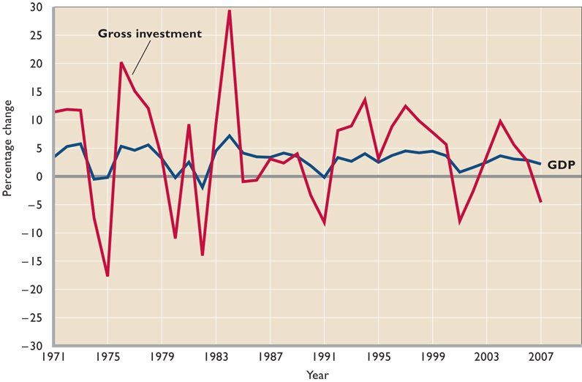
7. Lower Corporate Income Tax Increases Investment

Slide 44
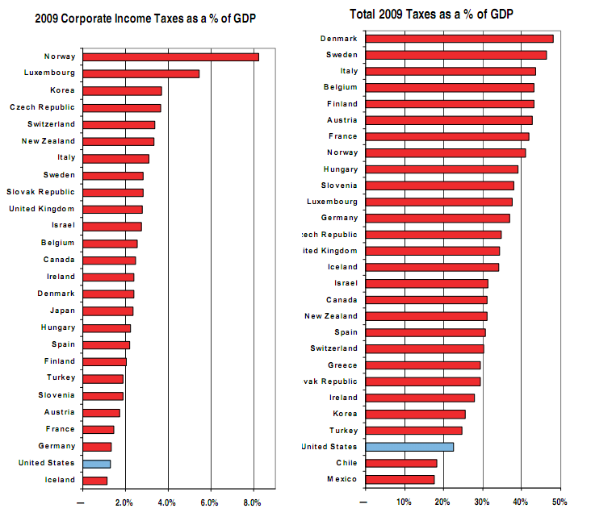
7. Lower Corporate Income Tax Increases Investment

Slide 45
Repatriation and International Corporations
In 2004, the America Jobs Creation Act (AJCA) permitted U.S. corporations to repatriate income held outside of the United States at an effective tax rate of 5.25 percent instead of the top 35 percent corporate income tax rate. The purpose of this tax provision was to encourage companies to return cash assets to the United States, which proponents of the provision argued would spur increased domestic investment and U.S. jobs. In response, corporations returned $312 billion in qualified repatriation dollars to the United States and avoided an estimated $3.3 billion in tax payments
A number of researchers have studied the impact of the reduction in the tax on repatriated earnings that came out of the American Jobs Creation Act. In short, the studies generally conclude that the reduction in the tax rate on repatriated earnings led to a sharp increase in the level of repatriated earnings, but that the repatriations did not increase domestic investment or employment. They further conclude that much of the repatriations were returned to shareholders through stock repurchases.”
Repatriating Offshore Funds: 2004 Tax Windfall for Select Multinationals (Senate Subcomittee on Investigations)

Slide 46
In Conclusion…
Please, please, please…
Read your news
Don’t believe the hype
Think about what you believe, why you believe it, and look up the truth in data
THANKS FOR COMING!!!

