Slide 1
What is the difference?
FEAR – is directed toward some external person, situation, or object like meeting a deadline, exam, etc.
Anxiety – an internal response to a vague, unrecognized danger like you feel something bad will happen or you might lose control of a situation.
Situational Anxiety – is anxiety that is unrealistic like driving on the freeways, seeing the doctor, etc.
Anxiety Disorder – intense anxiety that lasts longer than normal e.g. months later after the danger is gone
Phobia – when person avoids the perceived danger like not driving on the freeway or seeing the doctor.

Slide 2

Panic Disorder
Episodes of intense fear that occur “out of nowhere” without any apparent cause.
Symptoms include: shortness of breath, chest pain, fears of going crazy or of dying, dizziness, faintness, feel like you are going to die, shaking, sweating, nausea, hot flashes, feeling spacey and a lost sense of self (depersonalization).
It’s a disorder when you’ve had 2 or more attacks and a month of worry over having more.
2% of population have disorder.

Slide 3
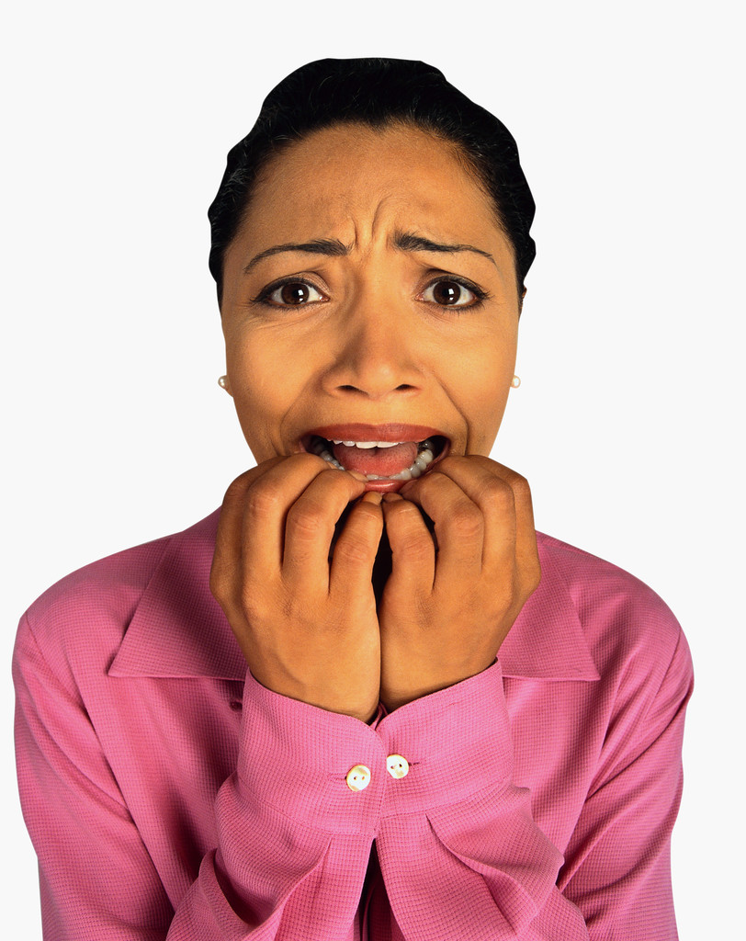
Social Phobia
A drive to avoid public places due to fear of embarrassment or humiliation.
Examples: a school setting, dating, parties, speaking, social functions, eating, etc.
2 -5% of population have this disorder.

Slide 4

Generalized Anxiety Disorder
Chronic anxiety that lasts longer than six months but is not accompanied by panic attacks, obsessions, or phobias.
The intensity and frequency are out of proportion to reality.
4% of population have this disorder.

Slide 5

Obsessive-Compulsive Disorder
Example: Chronic anxiety around need to be tidy/orderly to an extreme that interferes with many areas of person’s life.
Common obsessions (thoughts) are hurting others, locking doors, leaving stove on, etc.
Common compulsions (behaviors) obsessively washing hands, avoiding toxic substances/shaking hands, counting and checking on stoves, etc.
3% of population is afflicted.

Slide 6
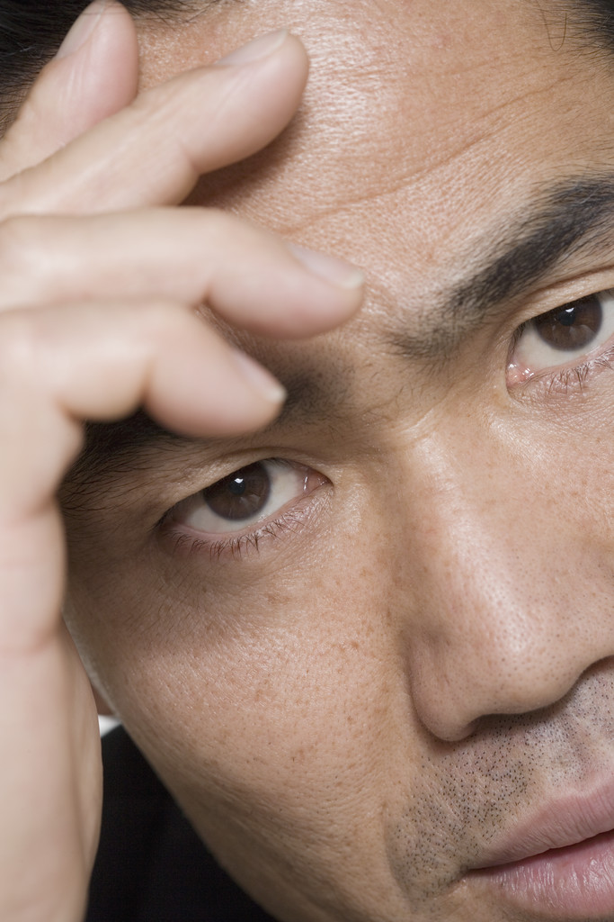
Post-Traumatic Stress Disorder
Occurs when a traumatic event from the past produces feelings of fear, terror, and helplessness in the present.
Identified in World War I as shell shock.
Symptoms include: nightmares, flashbacks, chronic anxiety, insomnia that lasts from weeks to years.

Slide 7
Causes of Anxiety Disorders
Heredity/Biological Causes (imbalance in brain)
Childhood Circumstances (divorce, perfectionistic)
Triggering Life Event Stressors (death, drugs, baby)
Conditioning (associations with old events: elevator)
Unhealthy Psychological Factors – beliefs, what if’s.
What if I have a heart attack?
I am a failure, unimportant, powerless, etc.
The world is dangerous….

Slide 8
Healing Physically
Breathing Techniques (4-7-8 method)
Progressive Muscle Relaxation
Exercise
Cat naps
Adequate Sleep

Slide 9
Healing Emotionally
Feelings of anger, hurt, and fear get buried in our body and suppression causes depression/anxiety.
Journaling: Express feelings through writing
Therapy: Express feelings through talking
Art Therapy: Express feelings through art
Music Therapy: Express feelings through music/dance
EMDR: (Eye Movement Desensitization Reprocessing
EFT (Emotional Freedom Technique)

Slide 10
Healing Behaviorally
Instead of resisting the fear/anxiety, observe, embrace, and confront it. Examples include:
Exposure Therapy: Confronting the phobia or feared object/event slowly over time.
Release Technique: Bring the fear to your chest and stomach area and say “yes” to it as you release it out of your stomach and chest area. Ask is it there because you fear you won’t have security, control, or approval.
Distraction Techniques: Immerse your life in a fun hobby. For panic attacks, breathe into a paper bag or splash your face with cold water, count backward from 100, or dance around to confuse your thoughts, but don’t stay still.

Slide 11
Healing Cognitively
Use self-talk to combat “what-if” thinking.
Use the judgment and perspective techniques from the book in chapters 2 and 7.
Use the Sedona Method: Ask yourself
Would I be willing to hold onto this forever?
Could I let this go?
Would I allow myself to let this go?
When? (Until you get a yes)

Slide 12
Healing Socially
Be able to set limits and boundaries with others.
Say no when you mean it and don’t let others pressure you.
Stand up for your rights and be assertive
Get support from others
Don’t talk about your condition too often or it will get worse.

Slide 13
Healing Spiritually
Find a broad purpose in your life that provides true meaning and purpose.
Anxiety could be a message to you to push you to explore an untapped potential in your self.
Use meditation or prayer.
Use Visualization
Use the “Heart” exercises from Chapter Two.

Slide 14
Healing the Whole Self
Low self-esteem from childhood are issues to address.
Issues include: insecurity, shame, guilt, inadequacy, abandonment, control, etc.
Heal the little boy or girl inside you using the 5- Step Fear Buster and methods from Chapter Four.
The child within is responsible for a large part of the anxiety one feels into adulthood. Communicate with him or her through writing, talking, EFT, etc.

Slide 15
Medication and Herbs
Anti-Anxiety Drugs like Valium, Xanax, and Ativan reduce anxiety. They are highly addictive and the side effect when coming off are the worst. Taper off when ready.
Anti-Depressant Drugs sometimes work to raise mood levels. They are also addictive with side effects.
Herbs like St. John’s Wort for depression, and Kava, Valerian Root, and amino acids like SAME can also help with anxiety.
Rule out hypothyroidism, hypoglycemis, cardio conditions, PMS, inner ear distrubances, deficiencies in minerals like calcium, magnesium, etc., withdrawal from alcohol, caffeine, food additives, toxins like pesticides, etc.

Slide 16
The Six Core Fears
Fear of Rejection, Ridicule, or Shame – Parents who were overly critical or punitive to their children instill it.
Fear of Loss of Control – If loved one died, or you were in an accident, natural disaster (fires), you feel like it could happen all over because you don’t have control.
Fear of Death, Injury, or Pain – If loved one died of cancer, you feel any minor ailment could be cancer.
Fear of Abandonment, Isolation, or Being Alone – occurs when parents were neglectful abusive, or unavailable. Later, feelings of loneliness can develop.
Fear of Confinement – parents were physically or sexually abusive and child couldn’t get away…trapped by kids/career.
Fear of Something Strange/Unknown – Occurs when dangers were over emphasized by parents. Could occur in a new environment.

Slide 17
The 5 Step Fear Buster
Trace the fear to an earlier time in your life. Example betrayal by boyfriend = betrayal by father
Release the feelings using the Emotional Healing Methods.
Communicate with inner child giving compassion and conviction you can “see this through.”
Use the Belief Changer from Chapter Two
Expose your self to the situation/person slowly, in a safe environment. Examples include: freeway driving, making a speech to 3, then 6, then 15, then 40 people.

