Slide 1
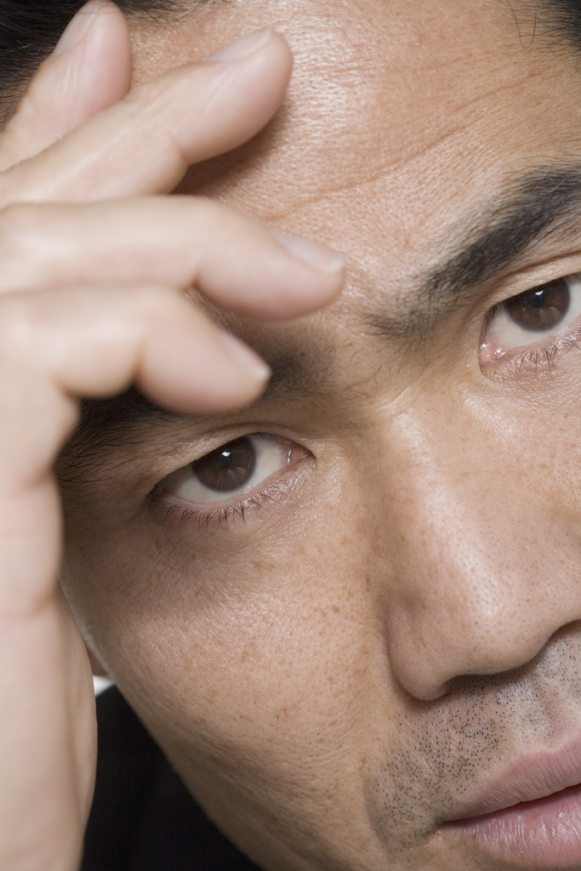
What is Depression?
A common and sometimes serious disorder of mood that causes feelings of sadness and hopelessness of an extended period of time.
It can prevent enjoyment of your work, health, life, and the people you care about.
It can be mild to intense and attack the mind and body at the same time.
It often shows up as something else, such as fatigue, insomnia, digestive problems, backaches, headaches, weight change, etc.

Slide 2
Symptoms of Depression
They become more intense over time.
Persistent sad, empty, depressed mood.
Loss of interest to enjoy pleasure in activities
Decreased energy and restlessness
Difficulty concentrating mor making decisions
Feelings of guilt and worthlessness
Thoughts of death or suicide
Complaints that have no physical cause

Slide 3
Types of Depression
Dysthymia – a milder, chronic form of depression that lasts two years or more.
Bipolar Depression – experiences extreme highs and lows of mood. It’s often disguised as substance abuse and triggered by a death, loss of job, or physical ability.
Seasonal Affective Disorder – Depression that occurs in the winter months.
Postpartum Depression – occurs in women the first few months of giving birth.
Major Depression – Long lasting throughout the lifespan when 5 or more symptoms from list occur.

Slide 4
Causes of Depression
Biological or genetic factors
Psychological factors such as pessimism, low self-esteem, ruminating thoughts, etc.
Social factors – People with poor or inadequate social skills correlate with higher rates
Stressful life events: divorce, loss of a loved one, loss of job, loss of health, and major stress that lasts for an extended period of time.

Slide 5
Treatment for Depression
Psychotherapy
Energy Psychology Methods
Antidepressant Medications
Light Therapy
Self-help groups
Exercise
Thinking positive
Distraction/Fun activities
Reaching out and serving others

Slide 6
Statistics
20 million Americans each year develop depression.
Women experience twice as often
By year 2020, depression will be the second most burdensome illness in the world.
About 2/3 of people who complete suicide have a depressive disorder
Depression has been linked with increases in risk, severity, and mortality of cancer and heart disease. Seniors are at greater risk of Alzheimer’s dementia, Parkinson’s disease, and a stroke.

